Slide 1

307307 Part 2 – Introduction to Neural Networks and Word Embeddings

Slide 2
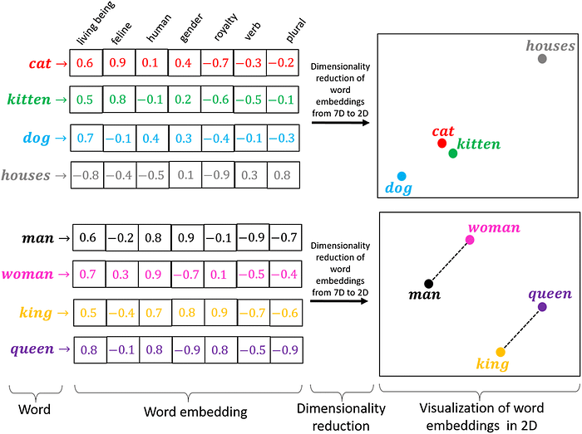
Preface
In the previous section, we used Bow and TDIDF to convert documents and words into numerical representations.
These representations were simple, they had no semantics for words, just on/off switches for existing and non-existing words in a document.
In this part of the course, we want to convert words into meaningful list of numbers.
These numbers are called Word Embeddings.
We will use Neural Networks to create these Word Embeddings.

Slide 3
Outcomes
Fundamentals of neural networks
Evolution from single Perceptrons to MLPs
Detailed MLP architecture (input, hidden, and output layers)
Mathematical representations
Various activation functions (Sigmoid, ReLU, etc.)
Backpropagation and training methodologies
Loss functions and optimization techniques
Architecture design considerations
Real-world applications
Advantages and limitations
Modern MLP variants and implementations

Slide 4
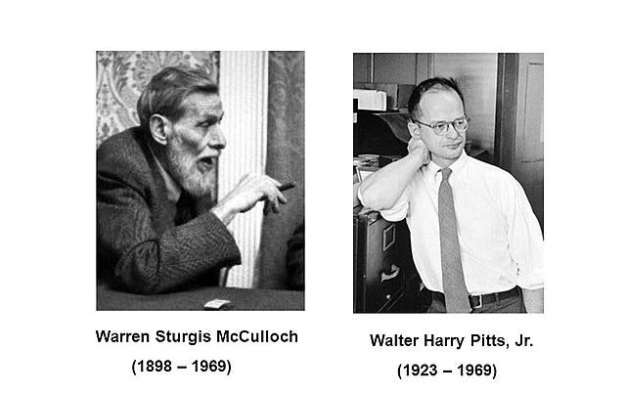
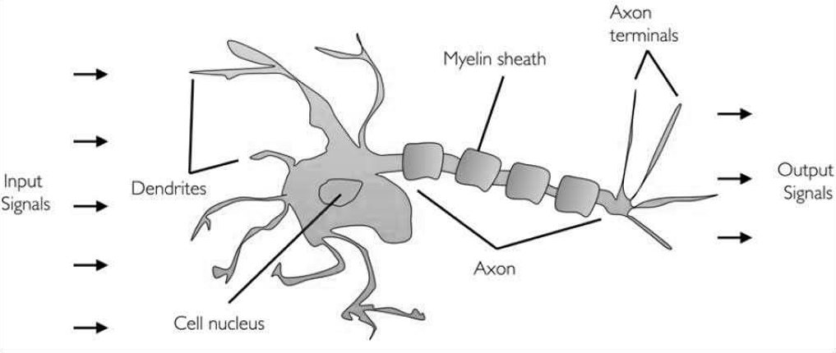
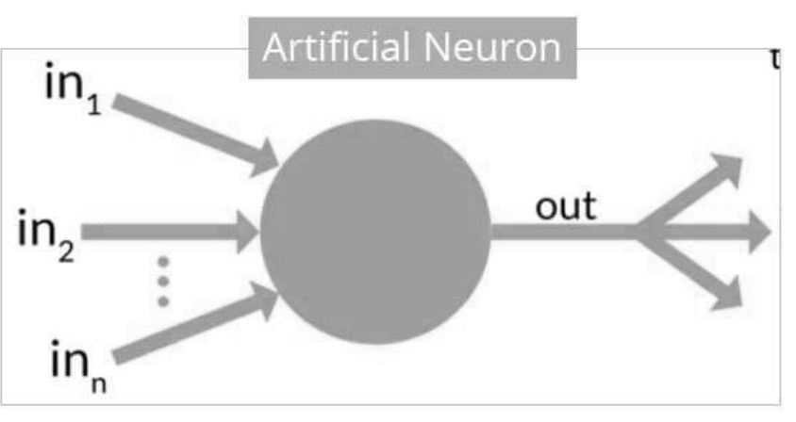
History of Neural Networks
In 1943, researchers Warren McCullock and published their first concept of simplified brain cell.
This was called McCullock-Pitts (MCP) neuron.
They described such a nerve cell as a simple logic gate with binary outputs.
Multiple signals arrive at the dendrites and are then integrated into the cell body, and, if the accumulated signal exceeds a certain threshold, an output signal is generated that will be passed on by the axon.

Slide 5
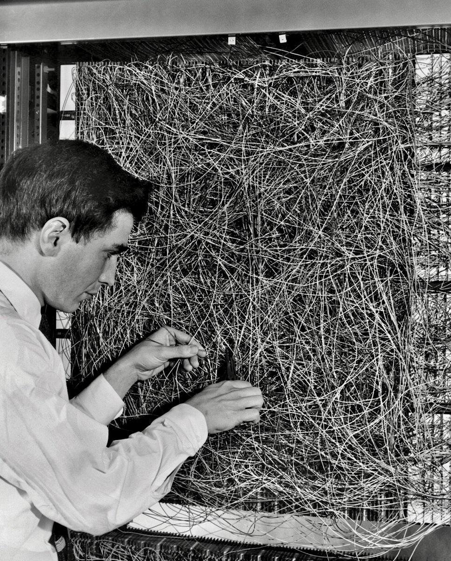
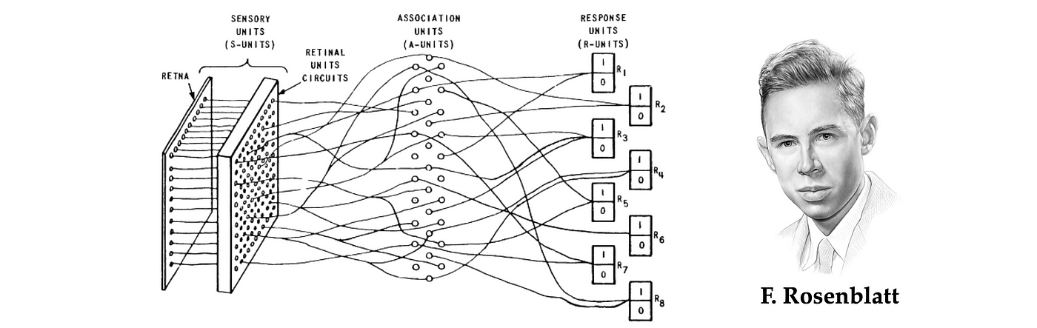
The Perceptron: Building Block of Neural Networks
In 1953, inspired by McCullock work, Frank Rosenblatt invented the Perceptron.
The Perceptron is the simplest form of a neural network
Binary classifier: separates data into two categories
Models a single neuron with multiple inputs and one output

Slide 6
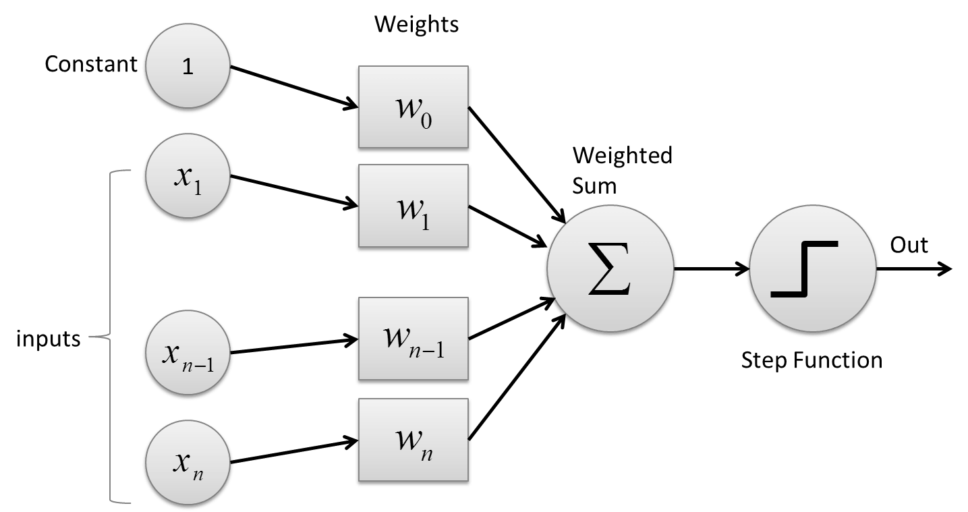
The Perceptron
Inputs: x₁, x₂, ..., xₙ
Weights: w₁, w₂, ..., wₙ
Bias: b
Activation function: Step function
Output: 1 if weighted sum > threshold, 0 otherwise

Slide 7
How a Perceptron Works
Multiply each input by its corresponding weight
Sum all weighted inputs
Add the bias term
Apply the activation function
Output the result
Mathematically:
z = w₁x₁ + w₂x₂ + ... + wₙxₙ + b
output = activation(z)

Slide 8
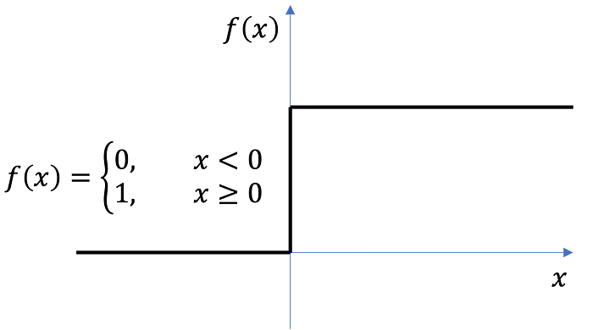
Perceptron Activation Function
Step Function:
Output: 1 if z ≥ 0, 0 if z < 0
Used in original perceptrons
Not differentiable at 0

Slide 9
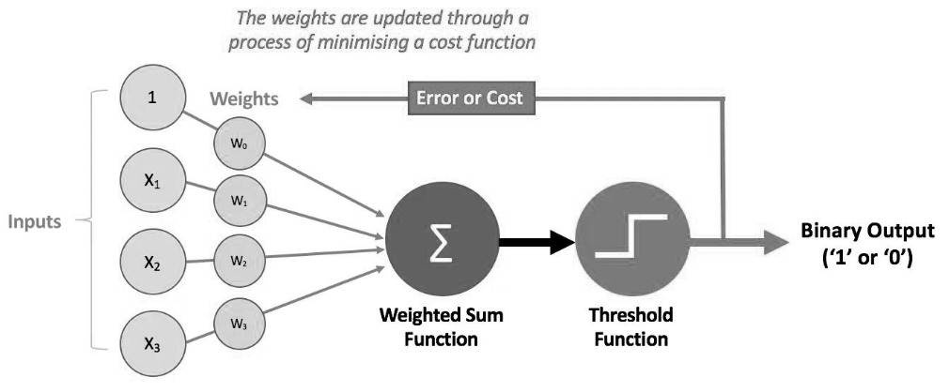
How Perceptron Learn (The Cost Function)
For each training example:
Calculate predicted output y_pred
Calculate error: error = y_true - y_pred
Update weights: w_new = w_old + learning_rate * error * x
Update bias: b_new = b_old + learning_rate * error

Slide 10
Step-by-Step Hand Calculation for AND Gate
Let's work through the perceptron learning algorithm by hand for the AND gate:
Training data: X = [[0,0], [0,1], [1,0], [1,1]], y = [0, 0, 0, 1]
Learning rate (η) = 0.1
Initial weights (randomly assigned): w₁ = 0.3, w₂ = -0.1
Initial bias: b = 0.2
First Iteration:
Example 1: (0,0) → 0
Inputs: x₁ = 0, x₂ = 0
Weighted sum: z = w₁x₁ + w₂x₂ + b = 0.3(0) + (-0.1)(0) + 0.2 = 0.2
Activation: output = 1 (since z > 0)
True output: y = 0
Error: error = y - output = 0 - 1 = -1
Weight updates:
w₁ = w₁ + η * error * x₁ = 0.3 + 0.1 * (-1) * 0 = 0.3
w₂ = w₂ + η * error * x₂ = -0.1 + 0.1 * (-1) * 0 = -0.1
b = b + η * error = 0.2 + 0.1 * (-1) = 0.1

Slide 11
Step-by-Step Hand Calculation for AND Gate
Example 2: (0,1) → 0
Inputs: x₁ = 0, x₂ = 1
Weighted sum: z = w₁x₁ + w₂x₂ + b = 0.3(0) + (-0.1)(1) + 0.1 = 0
Activation: output = 1 (since z ≥ 0)
True output: y = 0
Error: error = y - output = 0 - 1 = -1
Weight updates:
w₁ = w₁ + η * error * x₁ = 0.3 + 0.1 * (-1) * 0 = 0.3
w₂ = w₂ + η * error * x₂ = -0.1 + 0.1 * (-1) * 1 = -0.2
b = b + η * error = 0.1 + 0.1 * (-1) = 0
Example 3: (1,0) → 0
Inputs: x₁ = 1, x₂ = 0
Weighted sum: z = w₁x₁ + w₂x₂ + b = 0.3(1) + (-0.2)(0) + 0 = 0.3
Activation: output = 1 (since z > 0)
True output: y = 0
Error: error = y - output = 0 - 1 = -1
Weight updates:
w₁ = w₁ + η * error * x₁ = 0.3 + 0.1 * (-1) * 1 = 0.2
w₂ = w₂ + η * error * x₂ = -0.2 + 0.1 * (-1) * 0 = -0.2
b = b + η * error = 0 + 0.1 * (-1) = -0.1

Slide 12
Step-by-Step Hand Calculation for AND Gate
Example 4: (1,1) → 1
Inputs: x₁ = 1, x₂ = 1
Weighted sum: z = w₁x₁ + w₂x₂ + b = 0.2(1) + (-0.2)(1) + (-0.1) = -0.1
Activation: output = 0 (since z < 0)
True output: y = 1
Error: error = y - output = 1 - 0 = 1
Weight updates:
w₁ = w₁ + η * error * x₁ = 0.2 + 0.1 * 1 * 1 = 0.3
w₂ = w₂ + η * error * x₂ = -0.2 + 0.1 * 1 * 1 = -0.1
b = b + η * error = -0.1 + 0.1 * 1 = 0
End of Iteration 1:
Updated weights: w₁ = 0.3, w₂ = -0.1
Updated bias: b = 0

Slide 13
Second Iteration
Example 1: (0,0) → 0
Inputs: x₁ = 0, x₂ = 0
Weighted sum: z = w₁x₁ + w₂x₂ + b = 0.3(0) + (-0.1)(0) + 0 = 0
Activation: output = 1 (since z ≥ 0)
True output: y = 0
Error: error = y - output = 0 - 1 = -1
Weight updates:
w₁ = w₁ + η * error * x₁ = 0.3 + 0.1 * (-1) * 0 = 0.3
w₂ = w₂ + η * error * x₂ = -0.1 + 0.1 * (-1) * 0 = -0.1
b = b + η * error = 0 + 0.1 * (-1) = -0.1
Example 2: (0,1) → 0
Inputs: x₁ = 0, x₂ = 1
Weighted sum: z = w₁x₁ + w₂x₂ + b = 0.3(0) + (-0.1)(1) + (-0.1) = -0.2
Activation: output = 0 (since z < 0)
True output: y = 0
Error: error = y - output = 0 - 0 = 0
Weight updates (no change as error = 0):
w₁ = 0.3
w₂ = -0.1
b = -0.1
After several iterations, the perceptron will converge to weights that correctly classify all AND gate examples.

Slide 14
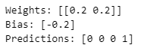
Python Implementation Perceptron from Scratch
from sklearn.linear_model import Perceptron
import numpy as np
# Training data for AND gate
X = np.array([[0, 0], [0, 1], [1, 0], [1, 1]])
y = np.array([0, 0, 0, 1])
# Initialize and train Perceptron
model = Perceptron(max_iter=100, eta0=0.1, random_state=42)
model.fit(X, y)
# Results
print("Weights:", model.coef_)
print("Bias:", model.intercept_)
print("Predictions:", model.predict(X))
The code shows a scikit-learn Perceptron implementation for the AND gate problem.
The code:
Imports NumPy, scikit-learn's Perceptron, and matplotlib
Sets up the training data for the AND gate
Initializes a Perceptron with 100 max iterations and a random seed of 42
Trains the perceptron on the AND gate data
Prints the learned weights, bias, and predictions
The output shows:
Weights: [[0.2 0.2]] - The perceptron learned to assign a weight of 0.2 to both inputs
Bias: [-0.2] - The bias is -0.2
Predictions: [0 0 0 1] - The perceptron correctly classified all four examples of the AND gate
With these weights and bias, the decision function is: 0.2×(input1) + 0.2×(input2) – 0.2
For the four input combinations:
[0,0]: 0.2×0 + 0.2×0 - 0.2 = -0.2 < 0 → output 0
[0,1]: 0.2×0 + 0.2×1 – 0.2 = 0 → output 0
[1,0]: 0.2×1 + 0.2×0 – 0.2 = 0 → output 0
[1,1]: 0.2×1 + 0.2×1 – 0.2 = 0.2 > 0 → output 1
This perceptron implements the AND gate logic.
The decision boundary is the line 2x₁ + 2x₂ - 0.2 = 0, which separates the point (1,1) from the other three points.

Slide 15
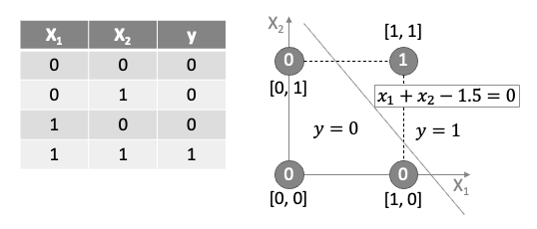
Decision Boundary
The perceptron learns a decision boundary: w₁x₁ + w₂x₂ + b = 0
Points above the line are classified as 1
Points below the line are classified as 0
For AND gate, only the point (1,1) should be above the line

Slide 16
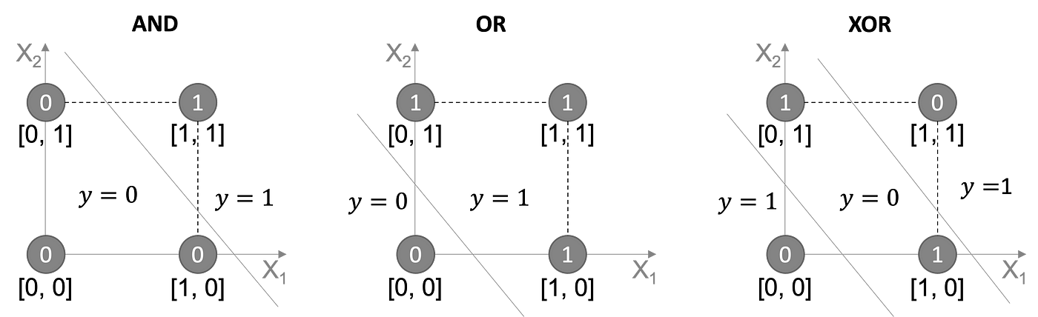
Limitations of Simple Perceptron
Can only learn linearly separable patterns
Cannot solve XOR problem (need multiple layers)
No probabilistic output
Simple update rule isn't suitable for complex problems

Slide 17
Introduction to Neural Networks
Multi-Layer Neural Networks

Slide 18
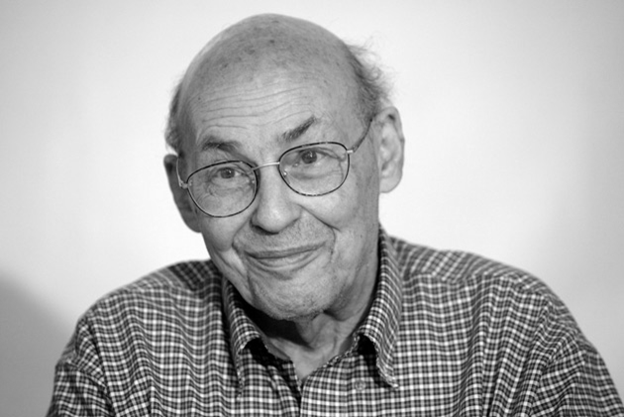
The Multi-Layer Percecptron (MLP)
Limitations of the Perceptron
While useful for linearly separable problems, the single perceptron cannot solve complex problems like XOR classification, as demonstrated by Minsky and Papert in their 1969 book "Perceptrons.“
The Multi-Layer Perceptron
The Multi-Layer Perceptron addresses the limitations of the single perceptron by introducing:
Multiple layers of neurons
Non-linear activation functions
More sophisticated learning algorithms

Slide 19
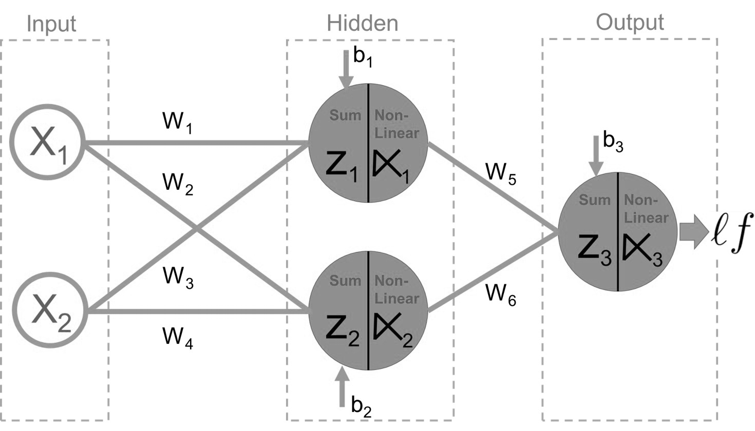
Structure of an MLP
Definition: An MLP is a class of feedforward artificial neural network that consists of at least three layers of nodes: input, hidden, and output layers.
Key Feature: Each neuron in one layer is connected to every neuron in the next layer (fully connected).
1. Input Layer
Receives the raw input features
One neuron per input feature
No computation occurs here; inputs are simply passed forward
2. Hidden Layer(s)
One or more layers between input and output
Each neuron in a hidden layer:
Receives inputs from all neurons in the previous layer
Computes a weighted sum
Applies a non-linear activation function
Passes the result to the next layer
3. Output Layer
Produces the final prediction or classification
Structure depends on the task:
Regression: Often a single neuron with linear activation
Binary classification: One neuron with sigmoid activation
Multi-class classification: Multiple neurons (one per class) with softmax activation

Slide 20
Structure of an MLP
3. Neurons and Connections
Each neuron computes a weighted sum of inputs and applies an activation function
Fully connected between layers (dense connections)
4. Activation Functions
Introduce non-linearity
Examples: ReLU, Sigmoid, Tanh, Softmax
5. Loss Function
Measures the error between predicted and true outputs
Examples: Mean Squared Error, Cross-Entropy
6. Optimizer
Updates weights to minimize loss
Examples: SGD, Adam
7. Training Data
Labeled data used to train the network
Split into training, validation, and test sets

Slide 21
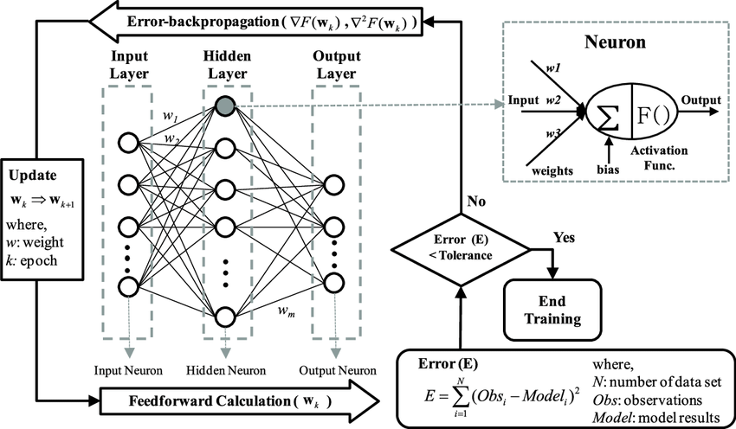
How an MLP Learn – Step by Step
Forward Propagation
Input features pass through the network layer by layer.
Each neuron computes a weighted sum of inputs and applies an activation function.
The final layer produces a prediction.
Loss Computation
A loss function measures the difference between predicted and actual outputs.
Common loss functions:
Mean Squared Error (regression)
Cross-Entropy Loss (classification)

Slide 22
How an MLP Learn – Training Process
Backpropagation
Gradients of the loss are calculated with respect to each weight using the chain rule.
This identifies how each weight contributed to the error.
Weight Update
An optimizer (e.g., SGD) adjusts weights to reduce loss:
w := w - learning_rate × gradient
This process repeats over multiple iterations (epochs) using training data.
Goal
Gradually minimize the loss and improve prediction accuracy.
Loss Function: MSE for regression, Cross-Entropy for classification.
Optimization: Backpropagation + Gradient Descent (or Adam).

Slide 23
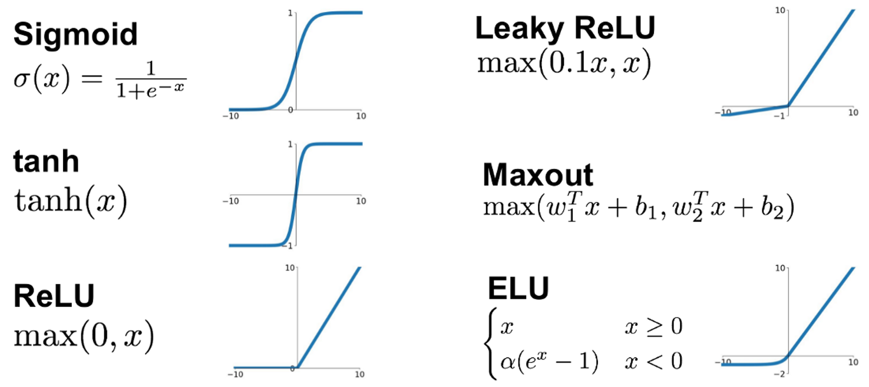
Activation Functions other than Step Function
Neural Networks use activation functions other than the simple step function in the Perceptron.
Activation Function helps the neural network use important information while suppressing irrelevant data points (i.e., allows local “gating” of information).
Common Activation Functions: A Toolbox for Neural Networks
Sigmoid: Compresses input to a range between 0 and 1.
Tanh: Like sigmoid but ranges from -1 to 1.
ReLU: Passes positive values, zeroes out negatives.
Leaky ReLU: Allows a small, non-zero gradient for negative inputs.
Maxout: Chooses the most active linear response.
ELU: Smoothly transitions through zero and allows negative outputs.
Each function offers a trade-off between simplicity, flexibility, and computational cost—choose based on the task and depth of your model
https://ml-explained.com/blog/activation-functions-explained

Slide 24
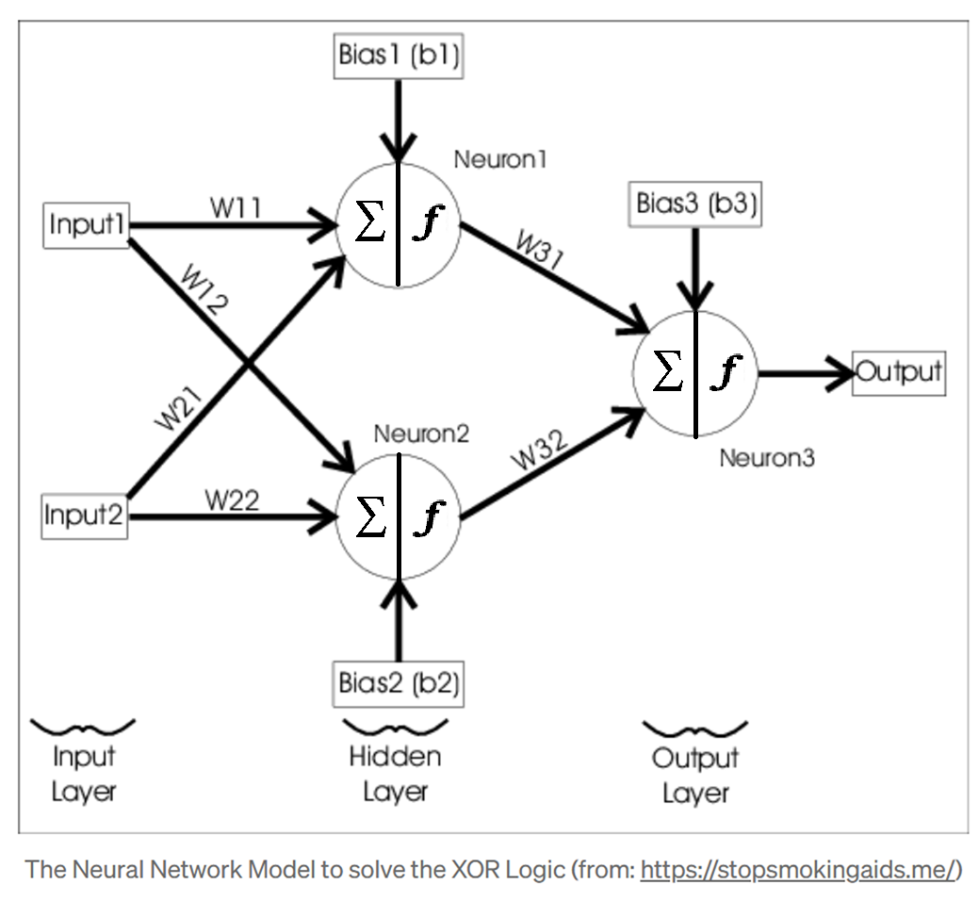
Representing Weights as Matrices
Matrix Representations for Weights
Weight Matrices:
W⁽¹⁾: Weights from Input to Hidden Layer
(shape: input_size × hidden_size):
[ w₁,₁⁽¹⁾ w₁,₂⁽¹⁾ ]
[ w₂,₁⁽¹⁾ w₂,₂⁽¹⁾]
Hidden Layer Bias (b₁):
[ b₁₁ b₁₂ ]
W⁽²⁾: Weights from Hidden to Output Layer
(shape: hidden_size × output_size):
[ w₁,₁⁽²⁾ ]
[ w₂,₁⁽²⁾ ]
Output Layer Bias (b₂):
[ b₂₁ ]
Forward Pass Matrix Operations:
Input to hidden layer: Z₁ = X · W₁ + b₁
Hidden to output layer: Z₂ = A₁ · W₂ + b₂
Backpropagation Matrix Operations:
Weight updates use matrix multiplication between layer activations and error gradients
W₂ update: W₂ += A₁ᵀ · delta₂ × learning_rate
W₁ update: W₁ += Xᵀ · delta₁ × learning_rate

Slide 25
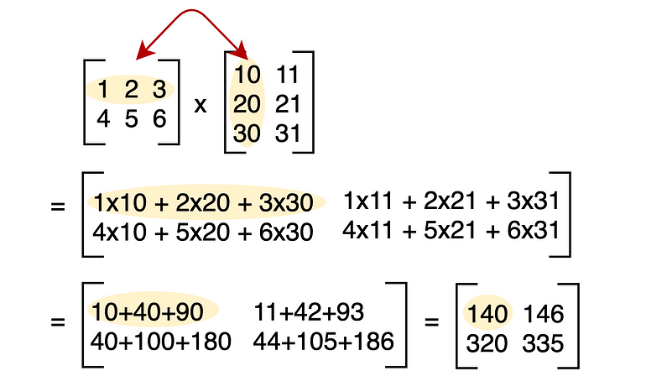
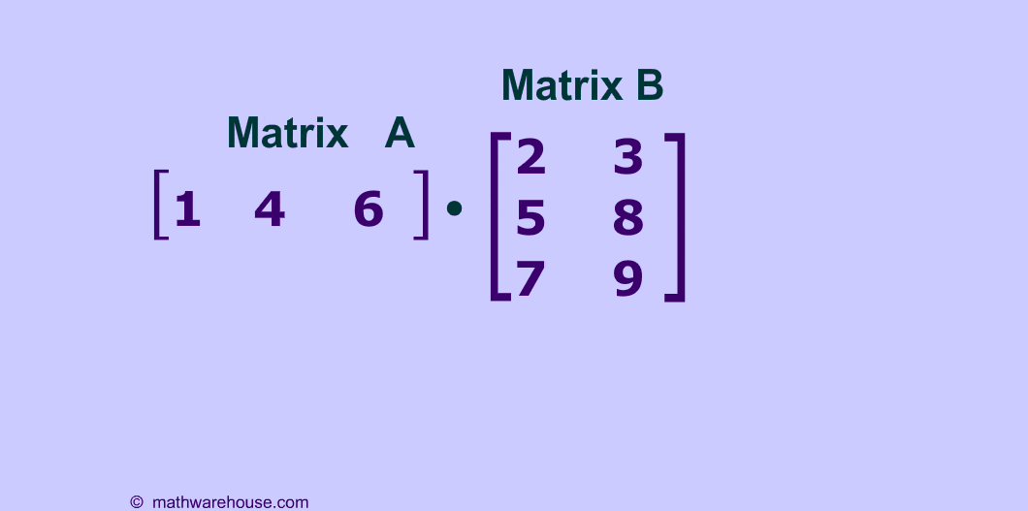
Matrix Multiplication

Slide 26
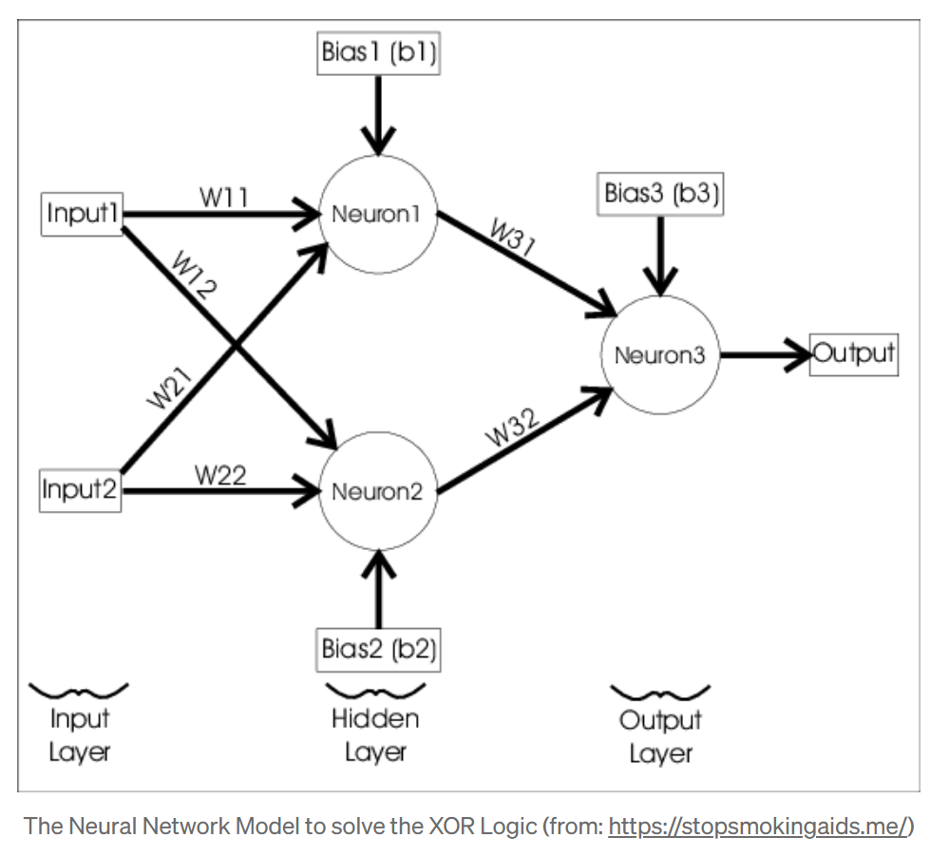
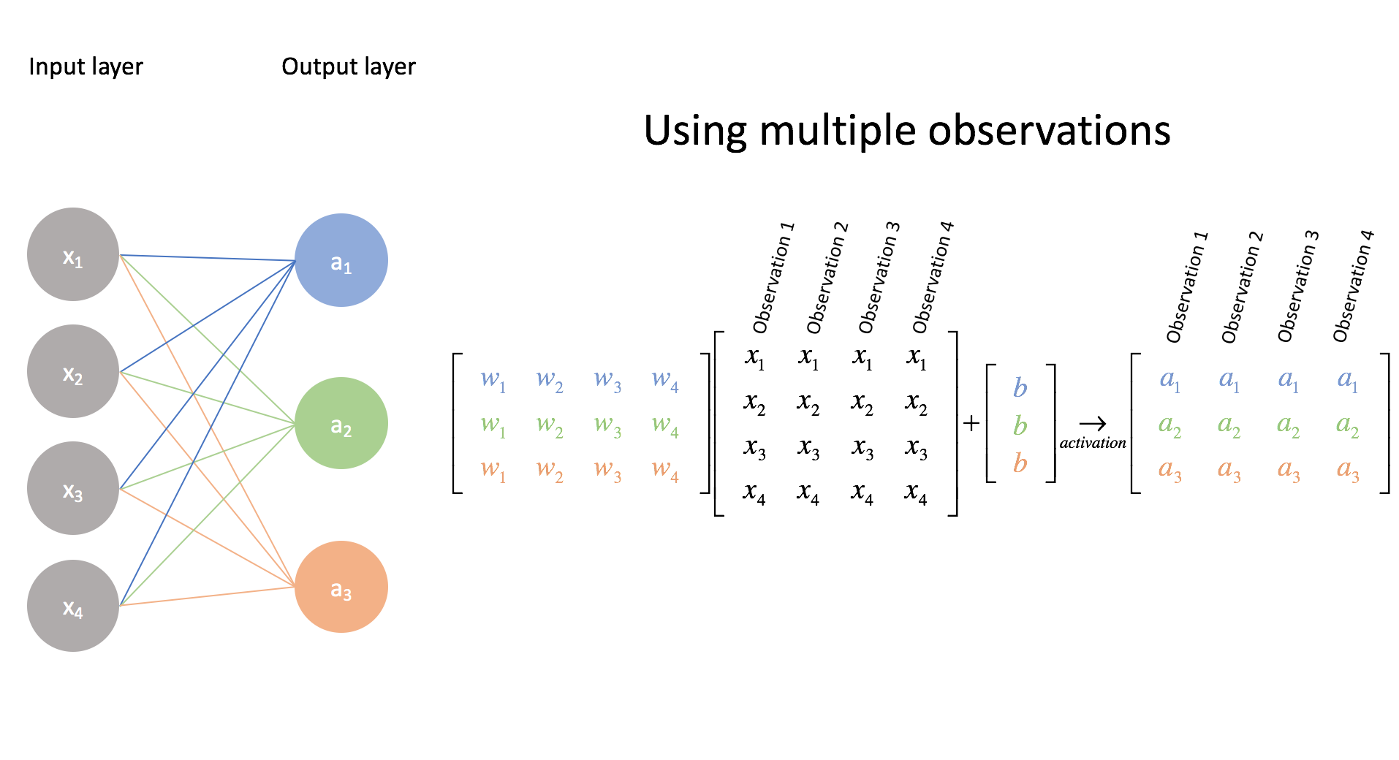
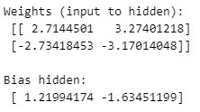
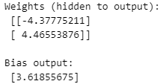
Multi-Layer Perceptron in Python
from sklearn.neural_network import MLPClassifier
import numpy as np
# XOR input and output
X = np.array([[0, 0], [0, 1], [1, 0], [1, 1]])
y = np.array([0, 1, 1, 0])
# Define MLP with 1 hidden layer of 2 neurons (minimal config for XOR)
mlp = MLPClassifier(hidden_layer_sizes=(2,), activation='tanh’, solver='adam', learning_rate_init=0.01, max_iter=10000, random_state=42)
# Train the model
mlp.fit(X, y)
# Make predictions
predictions = mlp.predict(X)
print("Predictions:\n", predictions)
print("\nWeights (input to hidden):\n", mlp.coefs_[0])
print("\nBias hidden:\n", mlp.intercepts_[0])
print("\nWeights (hidden to output):\n", mlp.coefs_[1])
print("\nBias output:\n", mlp.intercepts_[1])

Slide 27

Simple Neural Network in Python
import numpy as np
# Simple feedforward neural network
def neural_network(x, weights):
# First hidden layer with ReLU activation
hidden = np.maximum(0, np.dot(x, weights[0]) + weights[1]) # ReLU activation # Output layer
output = np.dot(hidden, weights[2]) + weights[3] return output
# Example network with random weights
input_size = 3
hidden_size = 4
output_size = 2
# Initialize random weights
W1 = np.random.randn(input_size, hidden_size) # Input → Hidden
b1 = np.random.randn(hidden_size) # Hidden bias
W2 = np.random.randn(hidden_size, output_size) # Hidden → Output
b2 = np.random.randn(output_size) # Output bias
weights = [W1, b1, W2, b2]
# Example input
x = np.array([0.5, 0.3, 0.2])
# Forward pass
prediction = neural_network(x, weights)
print(f"Network prediction: {prediction}")

Slide 28
Backpropagation (Conceptual)
import numpy as np
# Simplified backpropagation example
def train_step(x, y_true, weights, learning_rate=0.01):
# Forward pass
hidden = np.maximum(0, np.dot(x, weights[0]) + weights[1]) # ReLU
y_pred = np.dot(hidden, weights[2]) + weights[3]
# Compute loss (Mean Squared Error)
loss = np.mean((y_pred - y_true)**2)
# Backpropagation (simplified)
# Output layer gradients
grad_y_pred = 2 * (y_pred - y_true) / len(y_true)
grad_W2 = np.dot(hidden.T, grad_y_pred)
grad_b2 = np.sum(grad_y_pred, axis=0)
# Hidden layer gradients
grad_hidden = np.dot(grad_y_pred, weights[2].T)
grad_hidden[hidden <= 0] = 0 # ReLU gradient
grad_W1 = np.dot(x.T, grad_hidden)
grad_b1 = np.sum(grad_hidden, axis=0)
# Update weights
weights[0] -= learning_rate * grad_W1
weights[1] -= learning_rate * grad_b1
weights[2] -= learning_rate * grad_W2
weights[3] -= learning_rate * grad_b2
return loss, weights
# Example usage
# (In practice, we would use frameworks like PyTorch or TensorFlow)

Slide 29
The Difference Between a Perceptron and an MLP?
Feature | Perceptron | Multilayer Perceptron (MLP)
Layers | Only 1 layer (no hidden layers) | 2+ layers (has hidden layers)
Activation Function | Step function (hard threshold) | Nonlinear (e.g., ReLU, sigmoid, tanh)
Learning Rule | Simple rule: update on error | Gradient descent + backpropagation
Tasks It Can Solve | Only linearly separable problems | Nonlinear, complex problems

Slide 30
Introduction to Word Embeddings

Slide 31
How Did We Represent Words Pre-2013
Traditional models like Bag-of-Words (BoW) or TF-IDF, treat words as independent, ignoring semantic similarity.
One-hot encoding: Sparse, binary vectors (dimension = vocabulary size)
Example: "king" and "queen" are as unrelated as "king" and "banana" in BoW.
Word | Dimension 1 (cat) | Dimension 2 (dog) | Dimension 3 (fish) | Dimension 4 (bird)
cat | 1 | 0 | 0 | 0
dog | 0 | 1 | 0 | 0
fish | 0 | 0 | 1 | 0
bird | 0 | 0 | 0 | 1

Slide 32
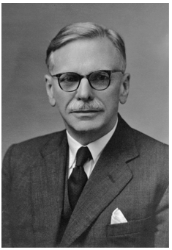
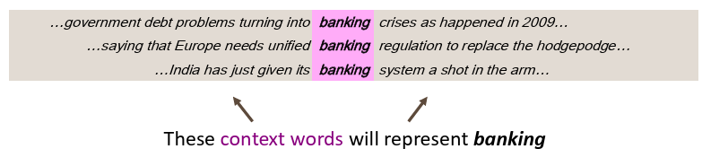
The Evolution of Word Representations
Problem: How do we represent meaning mathematically?
Solution: Distributional hypothesis - "You shall know a word by the company it keeps" (J.R. Firth, 1957)
J.R. Firth did not provide a detailed technical implementation like an algorithm or computational method. His statement was more of a linguistic philosophy or a theoretical principle, not a specific engineering method.
And much later, it inspired the distributional hypothesis in computational linguistics, especially by scholars like Zellig Harris and later computational models (Word2Vec, etc.)

Slide 33

Word2Vec (Tomas Mikolov et al., 2013)
Developed by Tomas Mikolov and team at Google.
Key Innovation
Transformed NLP by creating dense vector representations through prediction-based models
Two Architectures
Continuous Bag of Words (CBOW):
Predicts target word from context words
Faster training, better for frequent words
Skip-gram:
Predicts context words from target word
Better for rare words, captures more semantic information
Characteristics
Uses shallow neural networks and trains on local context windows.
Typically, 100-300 dimensions (vs. vocabulary size)
Linear relationships: king - man + woman ≈ queen
Efficient training through negative sampling
Limitations: Fixed vectors, one vector per word regardless of context

Slide 34
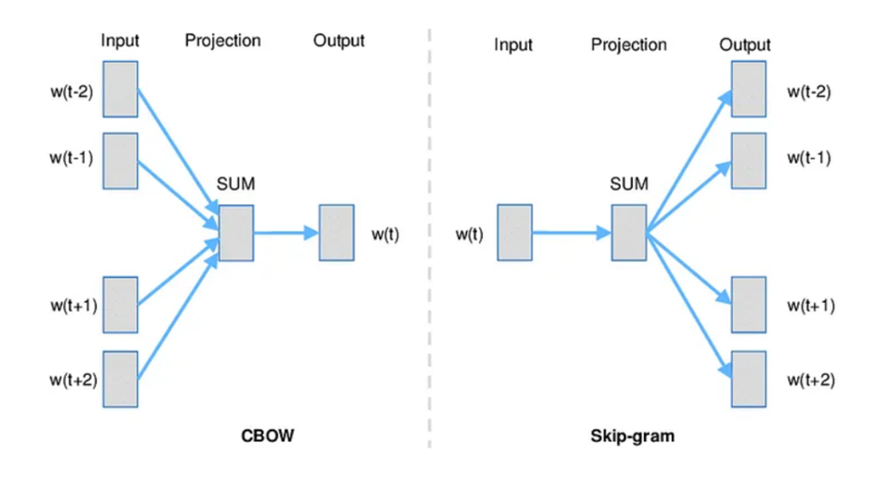
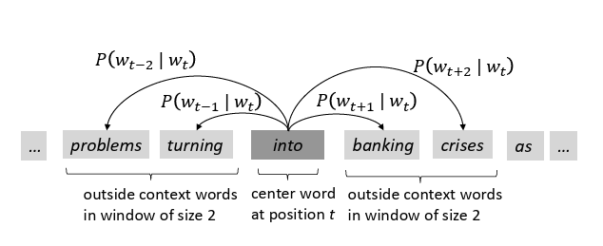
CBow and Skip-Gram Models
For each position 𝑡=1,…,𝑇, predict context words within a window of fixed size m, given center word 𝑤𝑡.

Slide 35
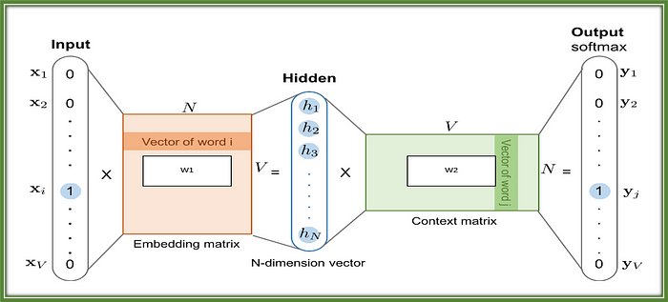
Skip-gram Architecture (Word2Vec)
This diagram illustrates how Word2Vec's Skip-gram model works:
Input: A one-hot encoded vector for the center word (word i).
Embedding Matrix: Multiplies the input vector to produce a dense embedding (N-dimensional vector) — this becomes the vector representation of the input word.
Context Matrix: The dense vector is then multiplied with another matrix to predict surrounding context words via softmax output.
Output: A probability distribution over the vocabulary, aiming to maximize the likelihood of actual context words.
This training process helps learn meaningful word vectors based on how words appear in context.
https://python.plainenglish.io/understanding-word-embeddings-tf-idf-word2vec-glove-fasttext-996a59c1a8d3

Slide 36
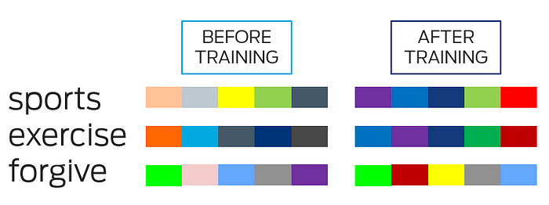
The Result of the Training Process - Similar Words -> Similar Vectors
Visual example of how embedding changes before and after training. `sports` and `exercise` have similar embedding value post training because they are closely related

Slide 37
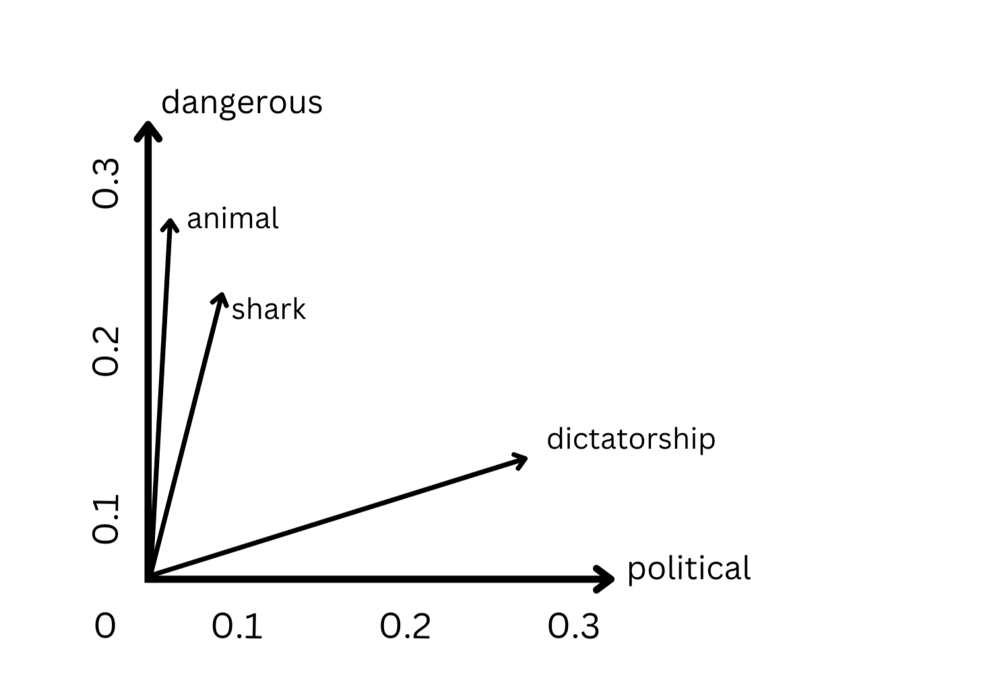
Vector Spaces and Word Embeddings
What is a Vector Space?
A mathematical space where each word is represented as a point (or vector) in multi-dimensional space.
Words are encoded as dense numerical vectors instead of one-hot or sparse representations (Word Embeddings) e.g., "king" → [0.21, 0.72,….,…., 0.35]
Word Embeddings captures semantic and syntactic relationships about/between words.
Each dimension potentially captures semantic meaning.
These vectors are learned from text by models like Word2Vec or GloVe.
Word | Dimension 1 (political) | Dimension 2 (dangerous)
shark | 0.05 | 0.22
animal | 0.03 | 0.25
dangerous | 0.07 | 0.32
political | 0.31 | 0.04
dictatorship | 0.28 | 0.15

Slide 38
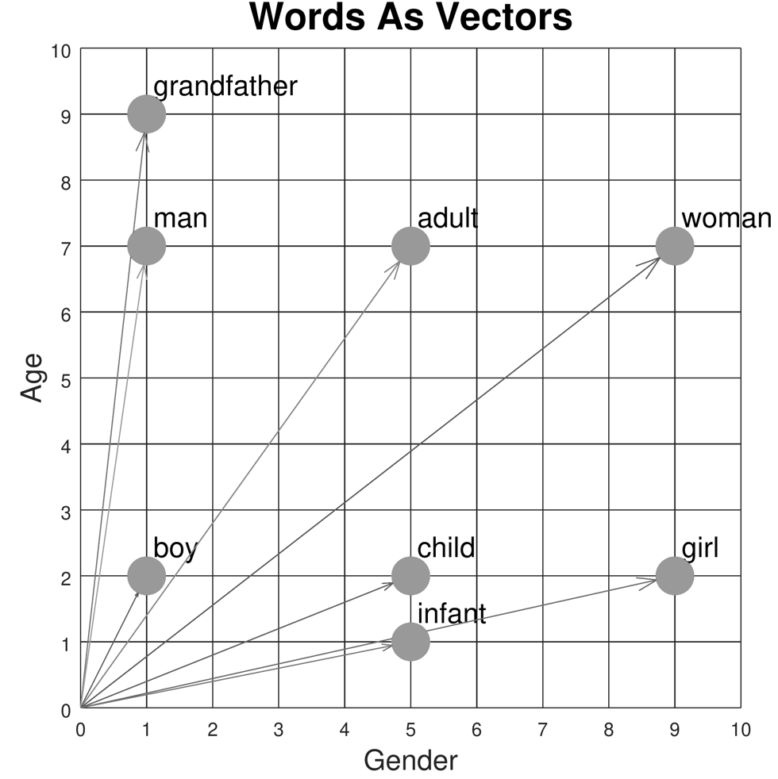
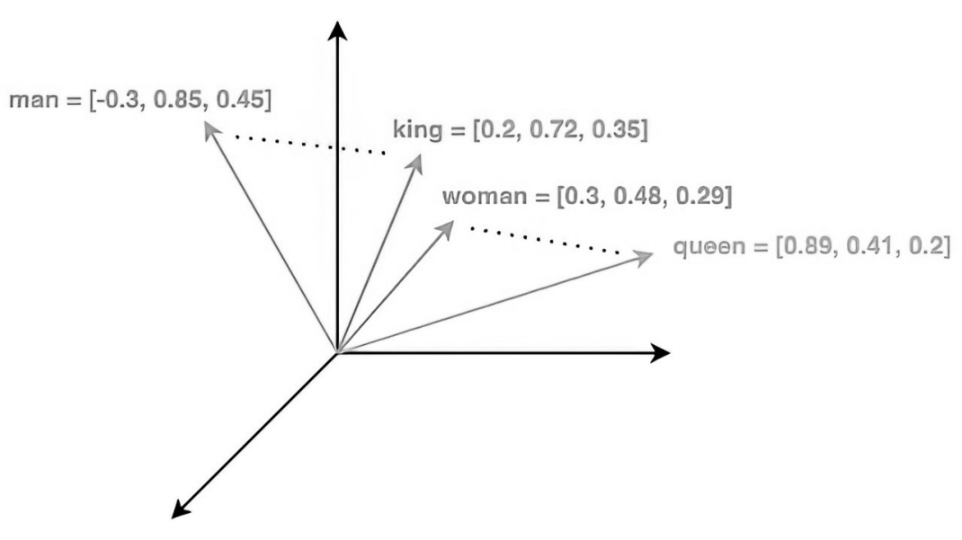
Vector Spaces and Word Embeddings
Why Use a Vector Space?
Makes it possible to compare, visualize, and manipulate meanings of words using math.
Enables operations like:
Similarity: "king" is close to "queen"
Analogy: "king" - "man" + "woman" ≈ "queen"
Properties of Vector Space
Semantic relationships are preserved (e.g., "shark" is closer to "dangerous" than "political").
Similar meanings → closer vectors.
Dissimilar meanings → vectors farther apart.

Slide 39
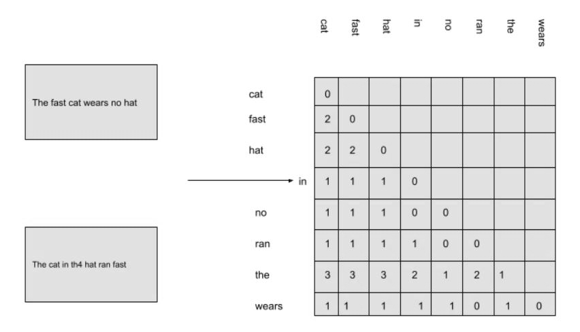
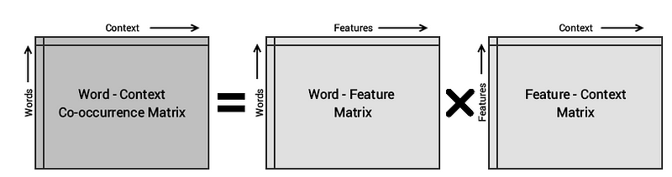
Glove (Pennington, Socher, Manning 2014)
Developed by Stanford NLP Group (Pennington, Socher, Manning)
Key Innovation
Bridges the gap between count-based methods and prediction-based methods by using global co-occurrence statistics to learn word vectors
Approach
Builds a word-word co-occurrence matrix over a large corpus
Learns embeddings by factorizing the matrix using a weighted least squares objective
Characteristics
Captures global statistical information while maintaining useful properties of local context
Produces dense word vectors (typically 100–300 dimensions)
Linear relationships in vector space are preserved: king - man + woman ≈ queen
Trained on massive corpora (Wikipedia, Common Crawl)
Limitations: Ignores context variability—still one vector per word regardless of usage

Slide 40
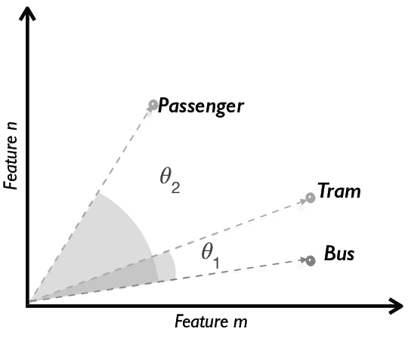
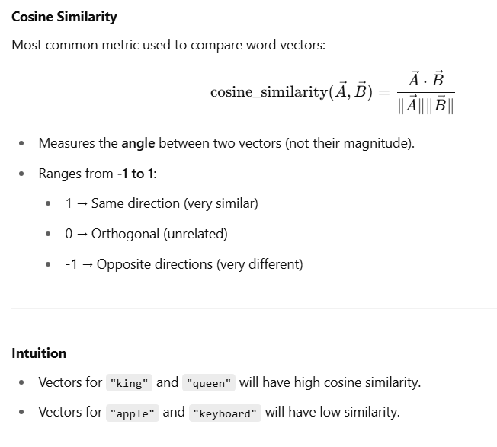
Measuring Similarity Between Word Vectors
Why Compare Word Vectors?
Word embeddings map words into a vector space.
Words with similar meanings are placed close together in that space.
To quantify this "closeness," we use vector similarity.

Slide 41
Experimenting with Fake Embeddings
import numpy as np
from sklearn.metrics.pairwise import cosine_similarity
# Fake word vectors (3D for simplicity)
word_vectors = {
"king": np.array([0.8, 0.65, 0.1]),
"queen": np.array([0.78, 0.66, 0.12]),
"man": np.array([0.9, 0.1, 0.1]),
"woman": np.array([0.88, 0.12, 0.12]),
"apple": np.array([0.1, 0.8, 0.9]),
}
def similarity(w1, w2):
return cosine_similarity([word_vectors[w1]], [word_vectors[w2]])[0][0]
print("Similarity(king, queen):", similarity("king", "queen"))
print("Similarity(man, woman):", similarity("man", "woman"))
print("Similarity(king, apple):", similarity("king", "apple"))

Slide 42
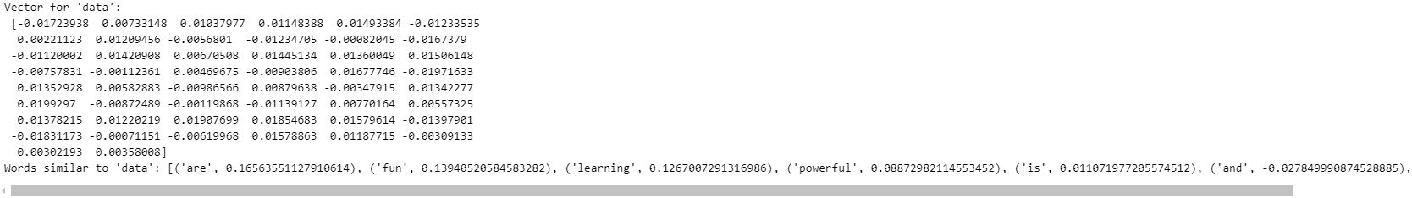
Learn Embeddings From Scratch
from gensim.models import Word2Vec
# Sample corpus
sentences = [['data', 'science', 'is', 'fun'],
['machine', 'learning', 'is', 'powerful'],
['data', 'and', 'learning', 'are', 'related']]
# Train the model
model = Word2Vec(sentences, vector_size=50, window=2, min_count=1, workers=2)
# Access the embedding for a word
print("Vector for 'data':\n", model.wv['data’])
# Find similar words
print("Words similar to 'data':", model.wv.most_similar('data'))

Slide 43
Use Pre-Trained Embeddings
Gensim
Gensim is a powerful open-source Python library designed specifically for unsupervised topic modeling and natural language processing tasks, with a strong focus on working with large corpora.
It excels in handling word embeddings and semantic similarity, offering efficient implementations of models like Word2Vec, FastText, and Doc2Vec.
Gensim is known for its memory-efficient, streaming-based approach, which allows it to process text data without loading everything into memory.
This makes it especially useful for working with real-world, large-scale text data.
import gensim.downloader as api
from gensim.models import Word2Vec
# Load pre-trained Word2Vec model
word2vec_model = api.load("word2vec-google-news-300")
# Find similar words
similar_words = word2vec_model.most_similar('computer', topn=5)
print("Words similar to 'computer':", similar_words)
# Word analogies
result = word2vec_model.most_similar(positive=['woman', 'king'], negative=['man'], topn=1)
print("king - man + woman =", result)
# Train your own Word2Vec model
sentences = [["cat", "say", "meow"], ["dog", "say", "woof"]]
model = Word2Vec(sentences, vector_size=100, window=5, min_count=1, workers=4)
# Get vector for a word
cat_vector = model.wv['cat']
print("Vector for 'cat':", cat_vector[:5]) # Show first 5 dimensions

Slide 44
Word Embeddings Example using Spacy Library
spaCy
spaCy is a fast and robust natural language processing library for Python that provides industrial-strength tools for text preprocessing and linguistic analysis.
It comes with pre-trained models for multiple languages and supports features like tokenization, part-of-speech tagging, named entity recognition, dependency parsing, and sentence segmentation.
spaCy is designed for performance and ease of use in production environments and integrates well with deep learning libraries.
While it's not primarily focused on word embeddings, it includes pre-trained word vectors and supports similarity comparisons out of the box.
pip install spacy
python -m spacy download en_core_web_md
import spacy
nlp = spacy.load("en_core_web_md")
word1 = nlp("king")
word2 = nlp("queen")
print("Similarity:", word1.similarity(word2))

Slide 45
Applications of Word Embeddings in NLP
1. Semantic Similarity Measure how similar two words, phrases, or documents are by comparing their vector representations. Example: Identifying that "doctor" and "physician" are closely related.
2. Text Classification Used as input features for tasks like spam detection, sentiment analysis, and topic classification. Embeddings provide rich, dense input for machine learning models.
3. Named Entity Recognition (NER) Help identify proper nouns and classify them into categories like person, location, or organization. Embedding-based models improve contextual understanding of named entities.
4. Machine Translation Map words from one language to another by aligning embeddings in multilingual space. Improves translation accuracy by leveraging semantic proximity.
5. Question Answering & Chatbots Used to understand queries and match them with appropriate answers or responses. Enable bots to interpret intent and context more accurately.
6. Information Retrieval Enhance search engines by retrieving results based on semantic meaning, not just keyword matches. Example: Searching for “heart attack” returns documents containing “cardiac arrest.”

